Slide 1
Analysis of Verified Replication Packages from the American Journal for Political Science
Mentor: Craig Willis
Summer Intern: Jingxian Na

Slide 2
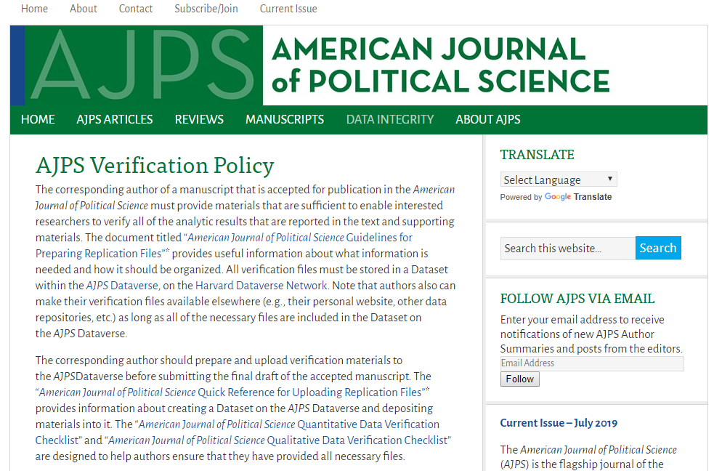
INTRODUCTION
Since 2015, the American Journal for Political Science (AJPS) started to require researchers upload replication materials (code, data, and metadata) that’s necessary to reproduce the analytic results and cooperated with Odum institute on the verification process:

Slide 3
INTRODUCTION
Therefore, it should be more likely to successfully reproduce the analytic results from packages deposited after the implementation of this policy than from packages deposited before the policy.
Used python to characterize datasets in AJPS Dataverse, including plot generation and identification of verified datasets.
Then tried to replicate two datasets that contains only R scripts.

Slide 4
First Step: download and characterize
Using Python to:
Get a list of DOI of all existing datasets in AJPS dataverse through its search API
Get the metadata of all these datasets through OAI_ORE exporter using DOI list
Do some analysis on the metadata

Slide 5
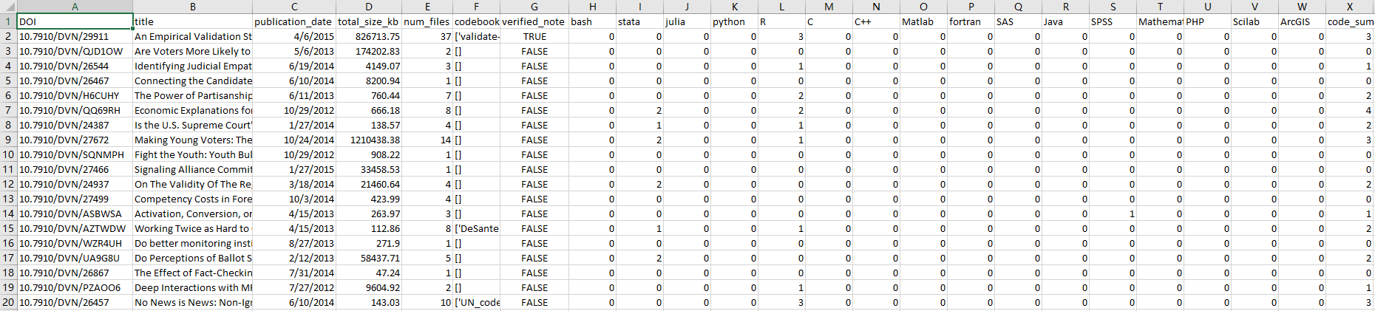
First Step: download and characterize
The title, publication date, number of files, total file size, if it contains a codebook, if it have gone through the Odum verification, and the number of script files in different coding language:

Slide 6
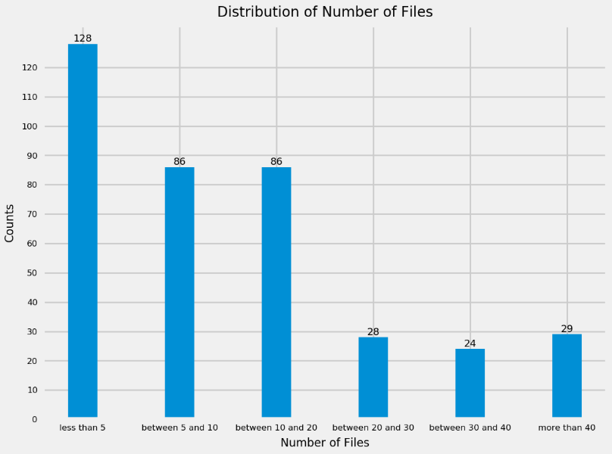
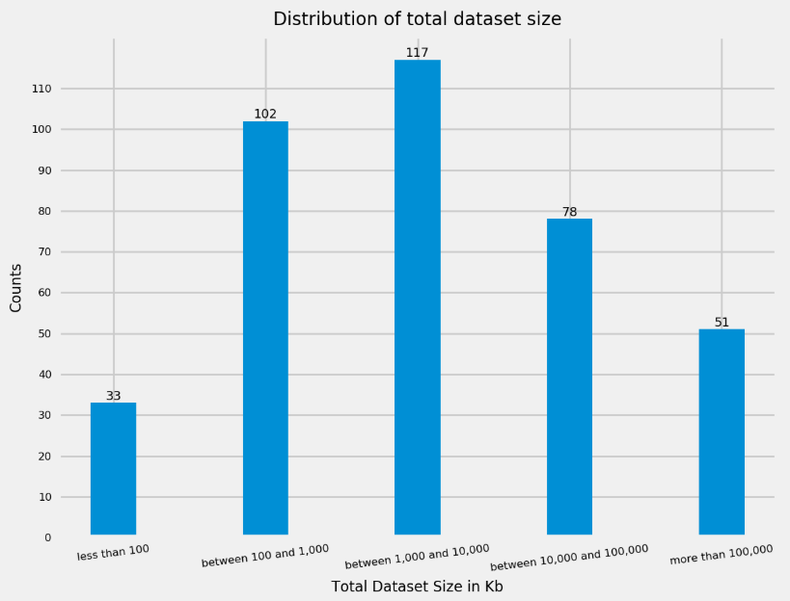
Second Step: generate some plots
Using the csv file I got from the first step, I drew some plots to get a whole view of the AJPS dataverse, notebook link: https://dashboard.wholetale.org/tale/view/5d406051cc895d0f74354993

Slide 7
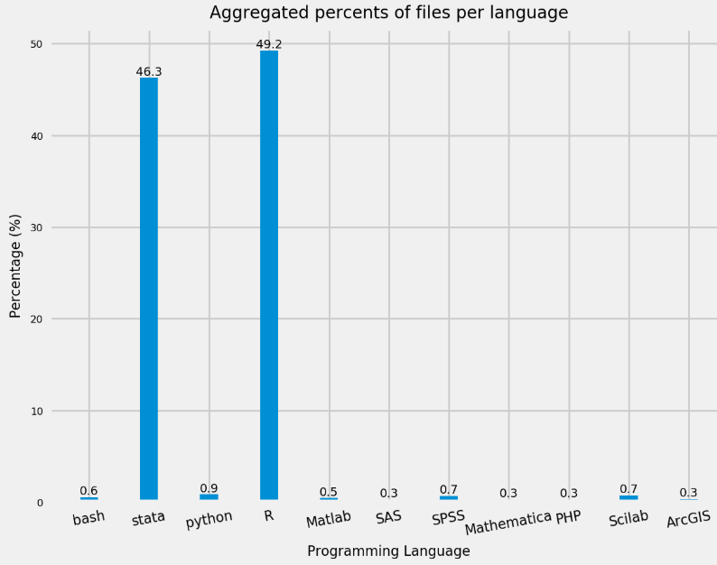
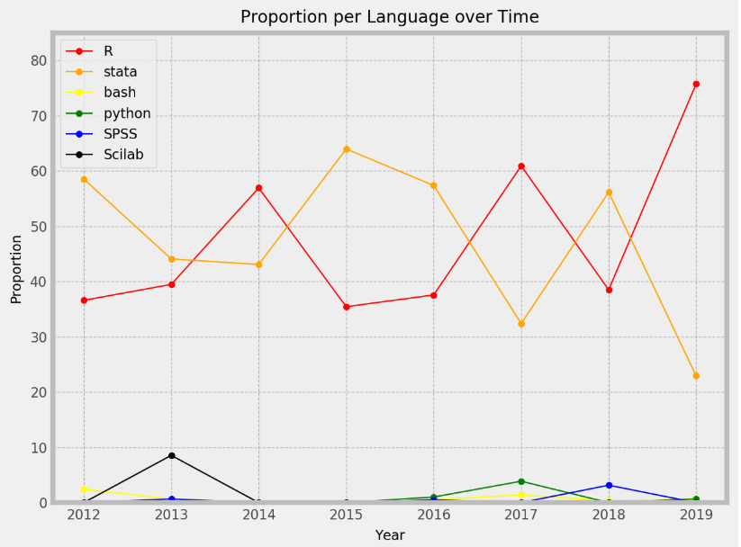
Second Step: generate some plots
Using the csv file I got from the first step, I drew some plots to get a whole view of the AJPS Dataverse:

Slide 8
Second Step: generate some plots
Based on the histograms and plots I got from the second step, R and stata are the two most popular coding language in AJPS Dataverse.
As a result, I decided to compare the verification process of two datasets that contains only R files, one of them has gone through the Odum verification and the other has not.

Slide 9
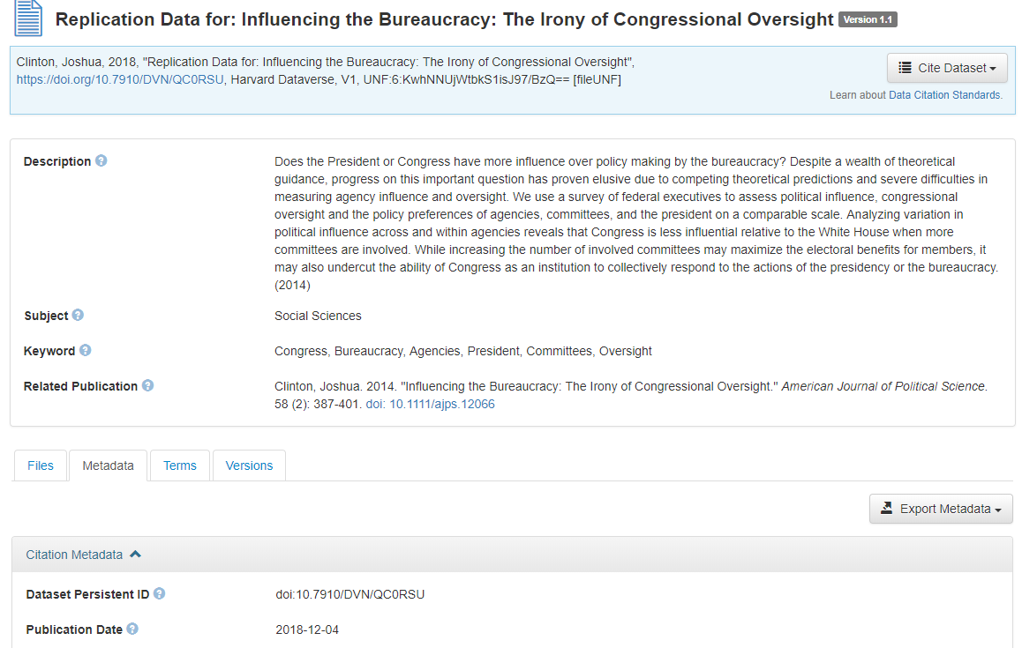
Third Step: identify verified datasets
As mentioned above, the replication policy was adopted by AJPS on March 2015. However, there are also some datasets in AJPS Dataverse that was published later than that date and have not been checked by Odum:

Slide 10
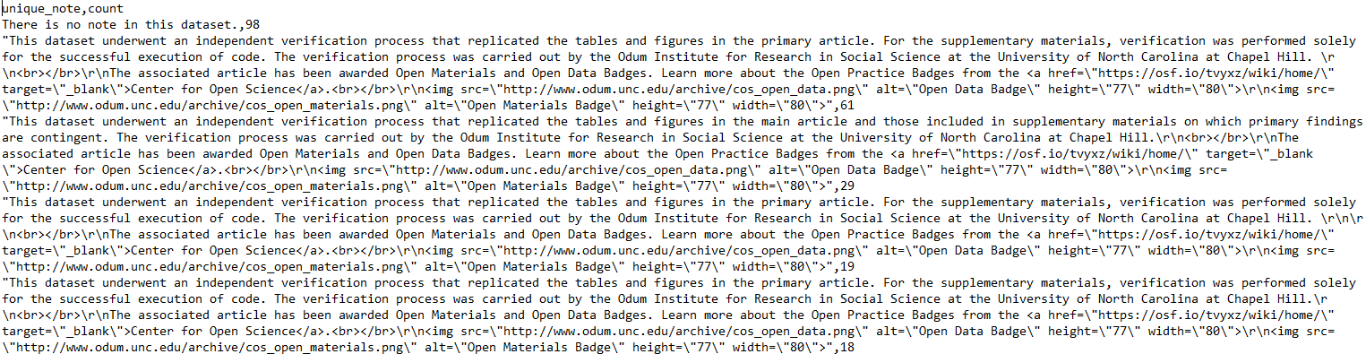
Third Step: identify verified datasets
In most cases, verified datasets would have corresponding statement in its “Notes” in Metadata, like “This dataset underwent an independent verification process…”.
However, these statements always varies from dataset to dataset:

Slide 11
Third Step: identify verified datasets
After analyzing all kinds of unique notes, we found that “independent verification” is a proper phrase to pick out all verified datasets.
Used this phrase as judging condition, divided verified datasets and others into two dataframes for further analysis.

Slide 12
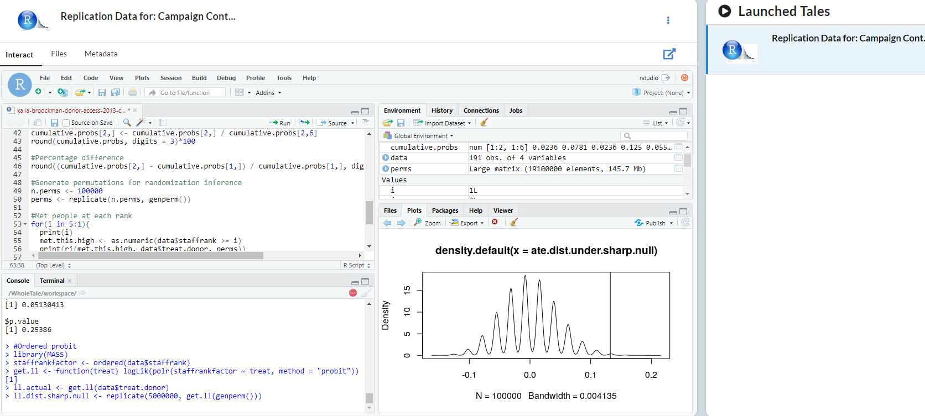
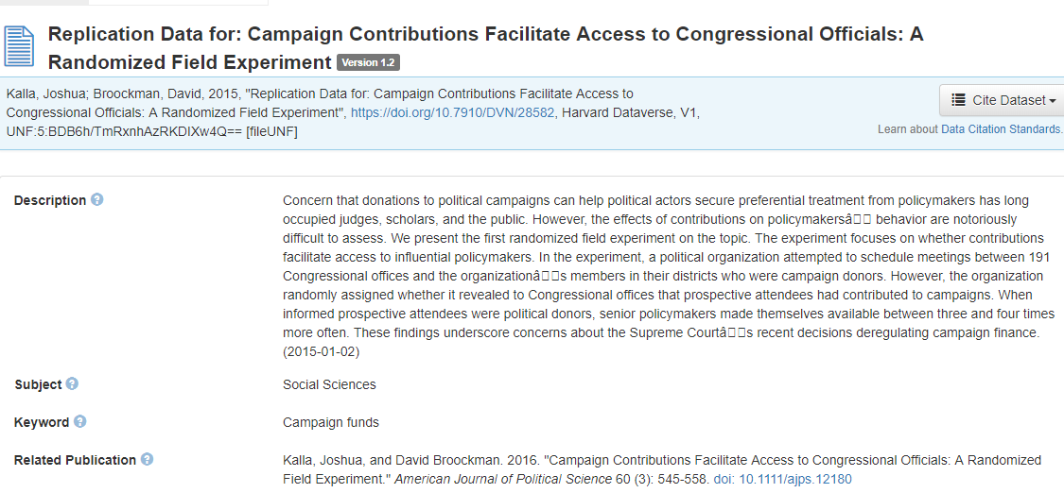
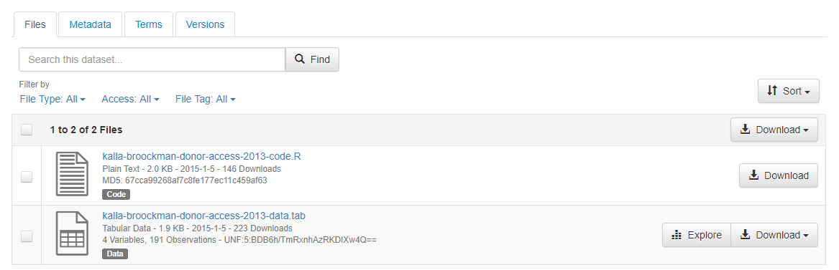
Fourth Step: draft verification report
The first dataset I verified is “Replication Data for: Campaign Contributions Facilitate Access to Congressional Officials: A Randomized Field Experiment”, it was published before March 2015 and has not gone through the Odum verification. There are two files contained in this dataset.

Slide 13
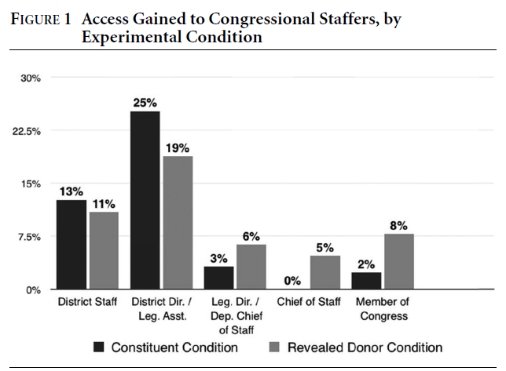
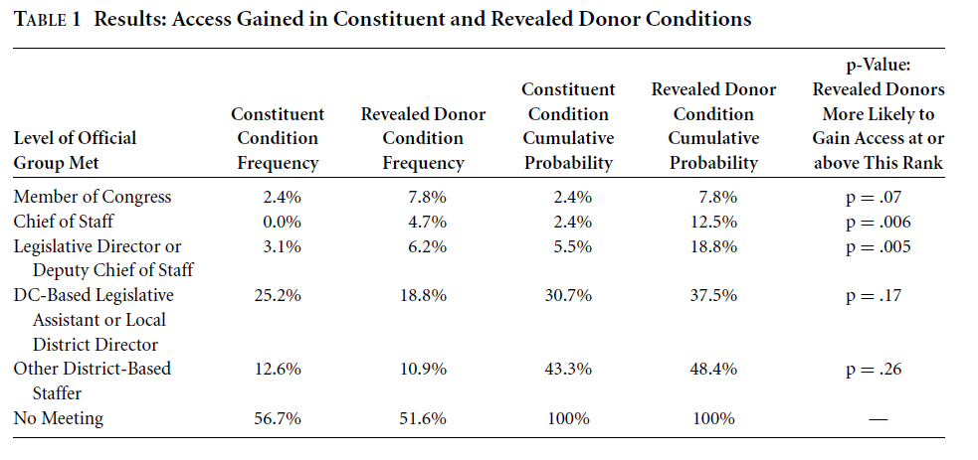
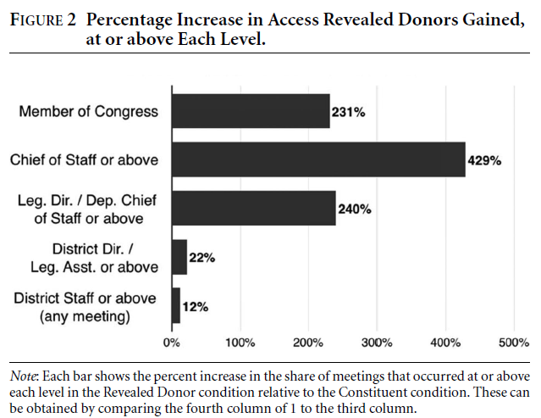
Fourth Step: draft verification report
There is a table and two figures in the corresponding article:

Slide 14
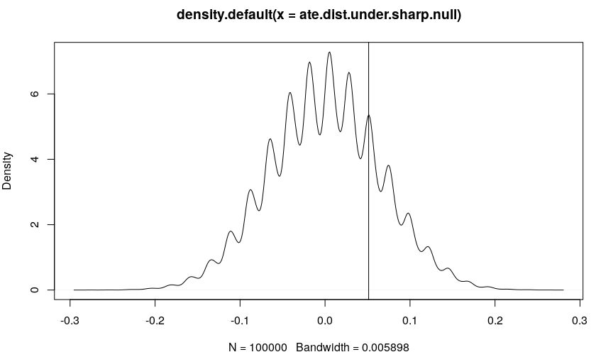
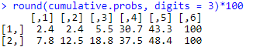
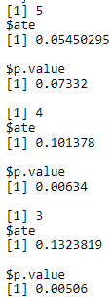
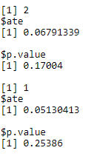
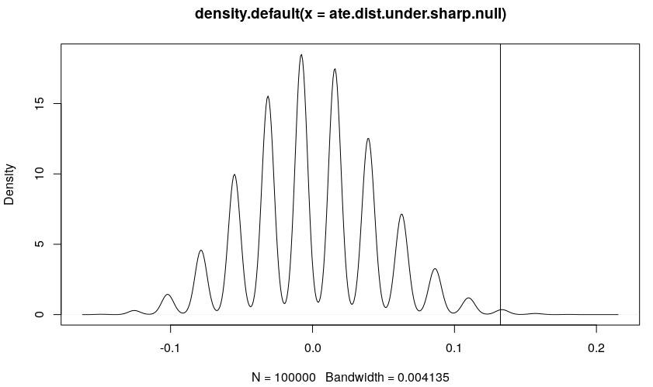
Fourth Step: draft verification report
Here is the output of the R file in dataset:

Slide 15
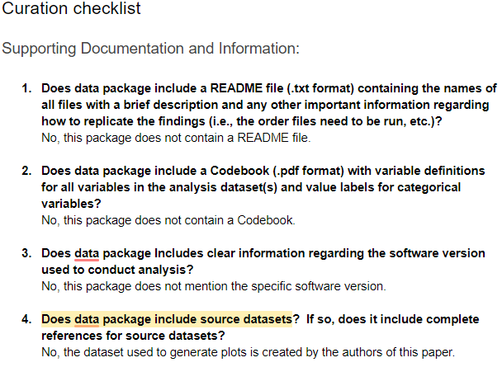
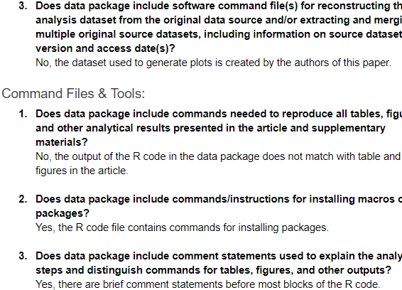
Fourth Step: draft verification report
As for the verification report, these problems are all from AJPS data verification checklist:

Slide 16
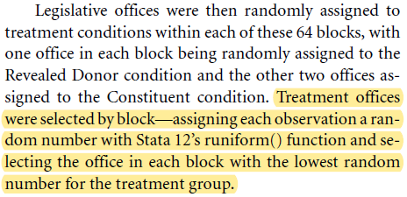
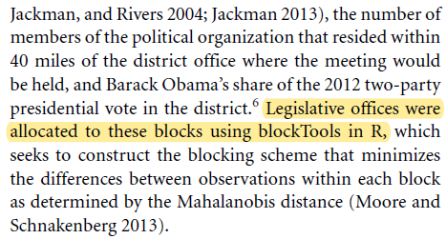
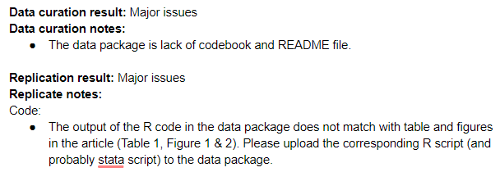
Fourth Step: draft verification report

Slide 17
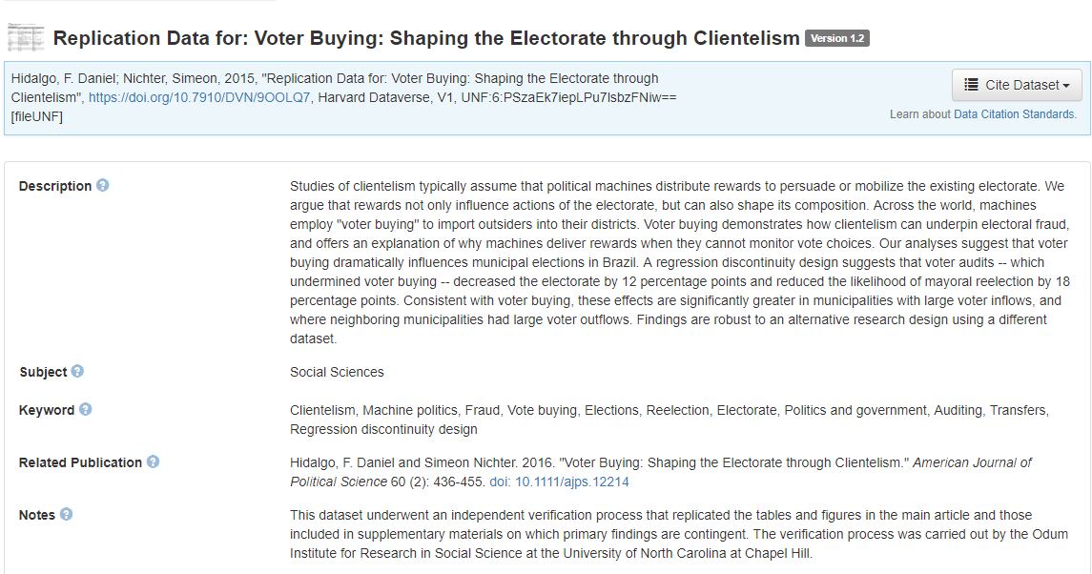
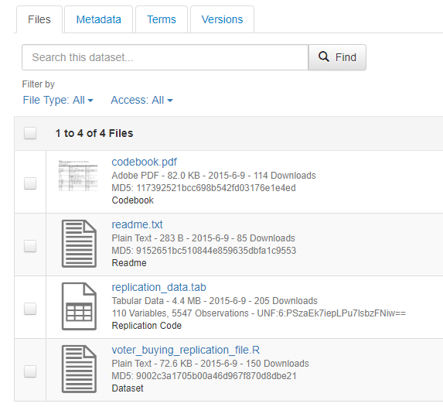
Fourth Step: draft verification report
The second dataset I verified is “Replication Data for: Voter Buying: Shaping the Electorate through Clientelism”, it was published after March 2015 and has already gone through the Odum verification. There are four files contained in this dataset.

Slide 18
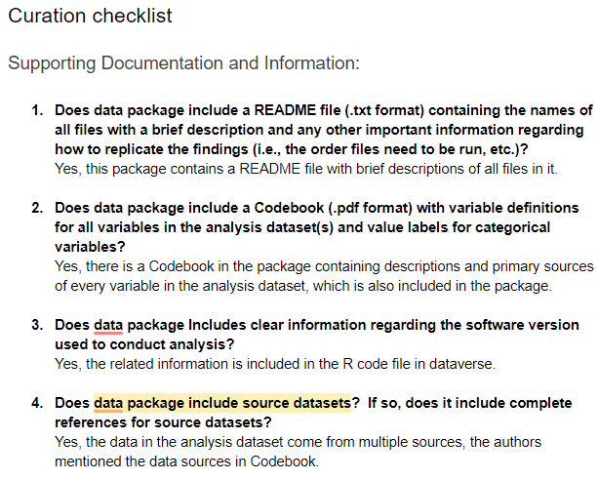
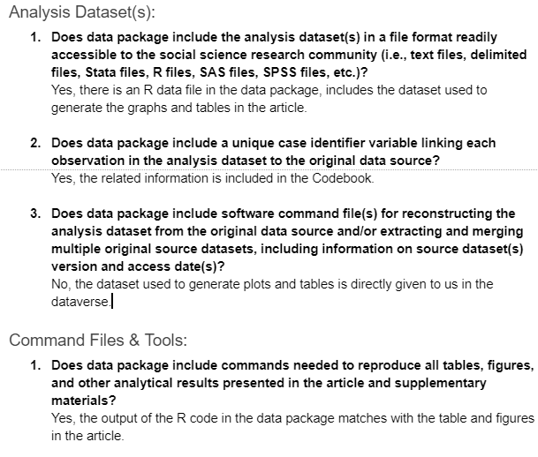
Fourth Step: draft verification report
There are seven graphs and three tables in the article, and almost all the R script outputs match with the analytic result in article, which is a huge improvement compared to the last dataset.

Slide 19
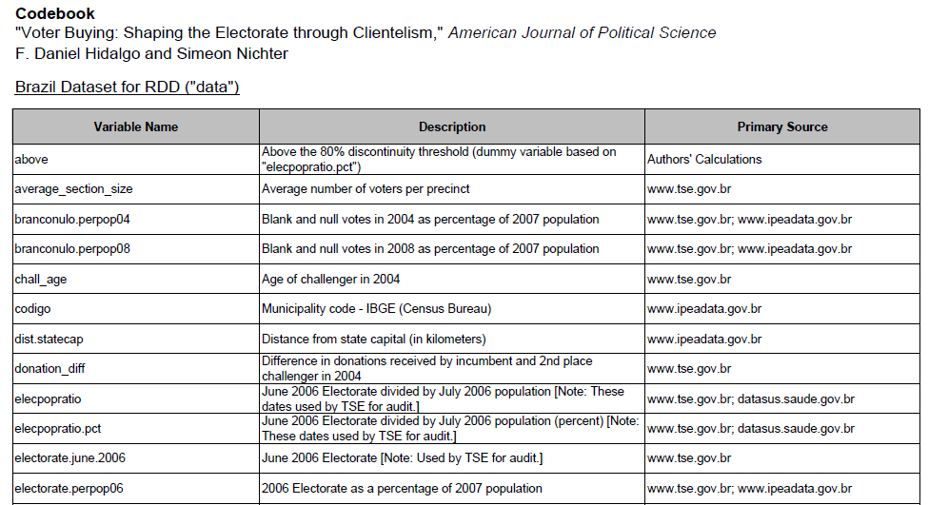
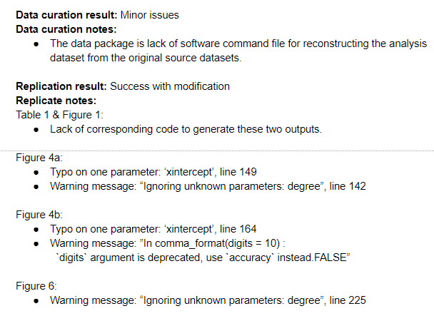
Fourth Step: draft verification report
However, there are still some minor problems:

Slide 20
Wrap up
Final Outputs:
One CSV file, 381 rows 24 columns, contains characteristic information of AJPS datasets.
One jupyter notebook, showing histograms and plots, giving a whole view of AJPS Dataverse.
Git repo: https://github.com/jingxianna/ajps-dataset-analysis, containing these two files along with python script and some other outputs (like file extension list).
Two replication tales in Whole Tale.

Slide 21
THANK YOU!
Q & A

